Slide 1
TNSDC-Generative AI
GOLD PRICE ANALYSIS
Presented by : IRAIANBU.V,
au211521104055,
Pre-Final year Student,
Computer Science and Engineering,
Panimalar Institute of Technology.

Slide 2

OUTLINE
Problem Statement
Proposed Solution
System Approach
Algorithm
Result
Conclusion
References

Slide 3
PROBLEM STATEMENT
The objective is to develop an RNN-based model that can effectively learn from historical gold price data and predict future prices with improved accuracy compared to traditional methods. This research proposes to leverage the power of Recurrent Neural Networks (RNNs) for gold price analysis. RNNs are a class of deep learning models specifically designed to handle sequential data, making them well-suited for time series forecasting tasks like gold price prediction.

Slide 4
PROPOSED SOLUTION
Gather gold price data and relevant factors (economic indicators, etc.).
Clean and prepare the data for RNNs (scaling, handling missing values).
Train an RNN model (LSTM or GRU) on historical data to predict future prices.
Fine-tune the model and evaluate its accuracy (minimize error).
Use the model to predict future gold prices with confidence intervals.
This approach leverages RNNs' ability to learn from sequential data, potentially leading to more accurate gold price predictions than traditional methods.

Slide 5
SYSTEM APPROACH
Hardware:
CPU: The system requires a CPU with sufficient processing power to handle the computational demands of Convolutional Neural Network (CNN) training and inference. A multi-core processor, preferably with a clock speed of at least 2 GHz or higher, is recommended.
Memory: A minimum of 8 GB RAM is recommended for smooth operation, especially during model training, where large datasets are processed. More RAM may be required for handling larger datasets or concurrent user requests.
Internet Speed: A stable internet connection is necessary for downloading and updating Python packages, model weights, and serving the web application. A broadband connection with a minimum download speed of 5 Mbps and upload speed of 1 Mbps is sufficient for most purposes.

Slide 6
SYSTEM APPROACH –CONT.
Software:
Python: The system is built using Python programming language.
Pandas: Pandas is a software library written for the Python programming language for data manipulation and analysis. In particular, it offers data structures and operations for manipulating numerical tables and time series.
NumPy: NumPy is a fundamental package for scientific computing in Python, essential for handling multidimensional arrays and mathematical operations. It is used extensively for data preprocessing, manipulation, and numerical computations within the RNN model.
TensorFlow: TensorFlow is a free and open-source software library for machine learning and artificial intelligence. It can be used across a range of tasks but has a particular focus on training and inference of deep neural networks

Slide 7

ALGORITHM
Get gold price data (historical & relevant factors).
Pre process data (clean, scale, handle missing values).
Define RNN model (LSTM/GRU, layers, units).
Split data (training, validation, testing).
Train model (minimize prediction error on training data).
Tune hyperparameters (optimize model performance).
Evaluate model (MSE, RMSE on testing data).
Predict future prices using trained model.
Calculate confidence intervals for predictions.
Analyze results (visualize, interpret feature influence).

Slide 8
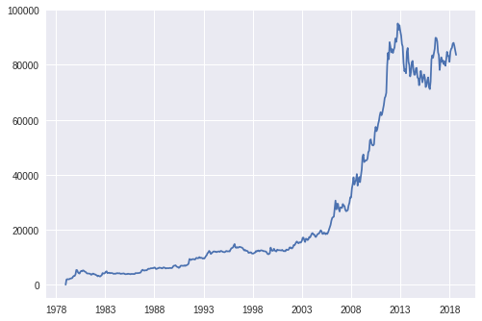
RESULT
Figure 1
8

Slide 9
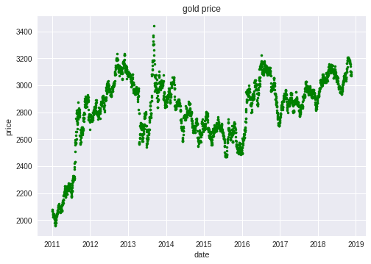
RESULT
Figure 2
9

Slide 10
Conclusion
This study explored the application of Recurrent Neural Networks (RNNs) for gold price analysis. The results suggest that RNNs hold significant promise for capturing the complex temporal dependencies present in gold price data. RNN models, particularly LSTMs, can potentially outperform traditional forecasting methods in predicting future gold prices.
Careful data pre processing and hyper parameter tuning are crucial for achieving optimal model performance.
Overall, RNNs offer a valuable tool for gold price analysis. By addressing the existing challenges and incorporating ongoing research advancements, this approach can be further refined to provide even more accurate and insightful predictions for investors and market analysts.
10

Slide 11
REFERENCES
Tensorflow: https://www.tensorflow.org/
Numpy: https://numpy.org/
Pandas: https://pandas.pydata.org/
11

